Slide 1
Java Loop Controls
Loop Controls

Slide 2
Java Loop Controls
There may be a situation when we need to execute a block of code several number of times, and is often referred to as a loop.

Slide 3
Print Hello World statement 10 times
Hello World
Hello World
Hello World
Hello World
Hello World
Hello World
Hello World
Hello World
Hello World
Hello World

Slide 4
Without using loop controls
public class Test {
public static void main(String args[]) {
System.out.println("Hello World");
System.out.println("Hello World");
System.out.println("Hello World");
System.out.println("Hello World");
System.out.println("Hello World");
System.out.println("Hello World");
System.out.println("Hello World");
System.out.println("Hello World");
System.out.println("Hello World");
System.out.println("Hello World");
}
}

Slide 5
Using Loop Controls
public class Test {
public static void main(String args[]) {
for(int i=1;i<=10;i++){
System.out.println("Hello World");
}
}
}

Slide 6
Java has very flexible three looping mechanisms. You can use one of the following three loops:
while Loop
do...while Loop
for Loop

Slide 7
While loop
A while loop is a control structure that allows you to repeat a task a certain number of times.

Slide 8
Syntax
while(boolean_expression){
//statementes
}

Slide 9
When executing, if the boolean_expression result is true, then the actions inside the loop will be executed. This will continue as long as the expression result is true.
Here, key point of the while loop is that the loop might not ever run. When the expression is tested and the result is false, the loop body will be skipped and the first statement after the while loop will be executed.

Slide 10
Example
public class Test {
public static void main(String args[]) {
int x = 1;
while (x <=10) {
System.out.print("value of x : " + x);
x++;
System.out.print("\n");
}
}
}

Slide 11
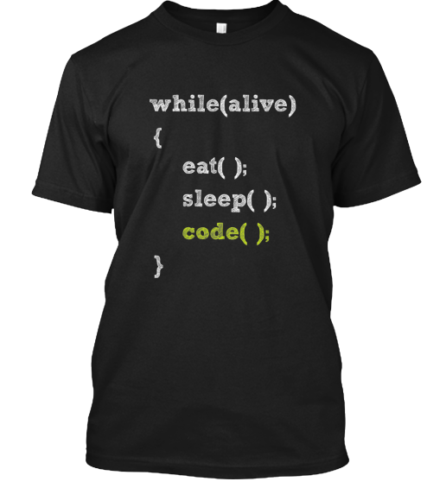
Funny example for while

Slide 12
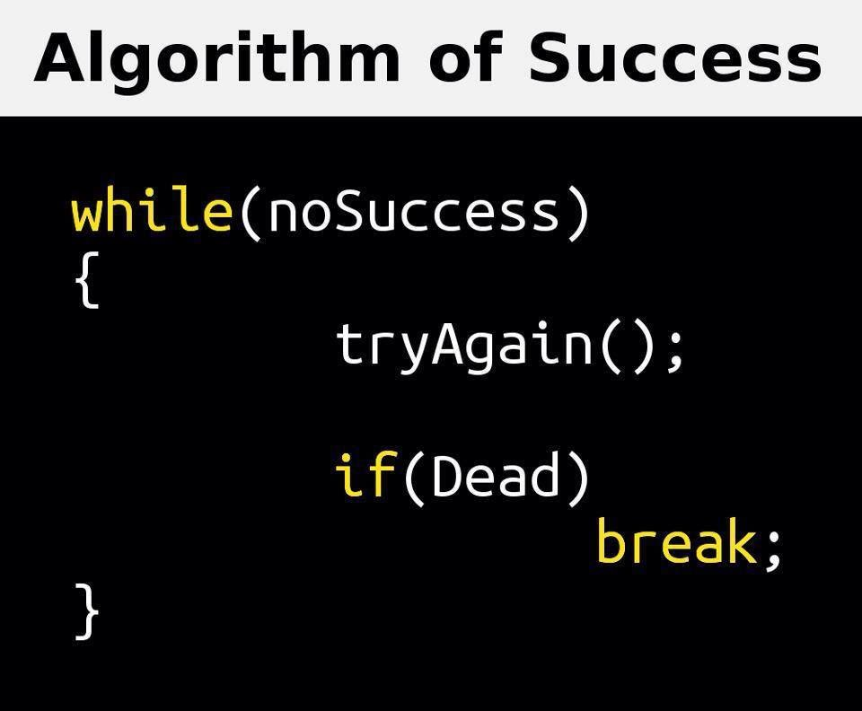

Slide 13
Guess the output
while(true){
System.out.println(“while statement”);
}

Slide 14
Guess the output
while(false){
System.out.println(“while statement);
}

Slide 15
Guess the output
int x = 10;
while (x < 20) {
System.out.print("value of x : " + x);
//x++;
System.out.print("\n");
}

Slide 16
do...while Loop
A do...while loop is similar to a while loop, except that a do...while loop is guaranteed to execute at least one time.

Slide 17
Syntax
do{
//statements
}while(boolean_expression);

Slide 18
Example
do {
System.out.println("do while block : "+x);
} while (x<20);

Slide 19
Example
public class Test {
public static void main(String args[]) {
int x = 10;
do {
System.out.print("value of x : " + x);
x++;
System.out.print("\n");
} while (x < 20);
}
}

Slide 20
output
value of x : 10
value of x : 11
value of x : 12
value of x : 13
value of x : 14
value of x : 15
value of x : 16
value of x : 17
value of x : 18
value of x : 19

Slide 21
Difference between while and dowhile?
The while statement verifies the condition before entering into the loop to see whether the next loop iteration should occur or not.
The do-while statement executes the first iteration without checking the condition, it verifies the condition after finishing each iteration.
The do-while statement will always execute the body of a loop at least once.

Slide 22
for Loop
A for loop is a repetition control structure that allows you to efficiently write a loop that needs to execute a specific number of times.
A for loop is useful when you know how many times a task is to be repeated.

Slide 23
syntax
for(variable initialization; boolean_expression; variable update){
//code to execute when condition is true
}

Slide 24
Flow of control in for loop
The initialization step is executed first, and only once. This step allows you to declare and initialize any loop control variables. You are not required to put a statement here, as long as a semicolon appears.
Next, the Boolean expression is evaluated. If it is true, the body of the loop is executed. If it is false, the body of the loop does not execute and flow of control jumps to the next statement past the for loop.
After the body of the for loop executes, the flow of control jumps back up to the update statement. This statement allows you to update any loop control variables. This statement can be left blank, as long as a semicolon appears after the Boolean expression.
The Boolean expression is now evaluated again. If it is true, the loop executes and the process repeats itself (body of loop, then update step, then Boolean expression). After the Boolean expression is false, the for loop terminates.

Slide 25
Example
public class Test {
public static void main(String args[]) {
for(int x = 10; x < 20; x = x+1) {
System.out.println("value of x : " + x );
}
}
}

Slide 26
output
value of x : 10
value of x : 11
value of x : 12
value of x : 13
value of x : 14
value of x : 15
value of x : 16
value of x : 17
value of x : 18
value of x : 19

Slide 27
Guess the outuput
for( ; ; ){
System.out.println("for statement");
}

Slide 28
Guess the output
for(int x = 10; x < 20;) {
System.out.println("value of x : " + x );
}

Slide 29
Guess the output
int i;
for( i = 1; i<=10 ; i++ ){
System.out.println("i value: "+i);
}

Slide 30
Guess the Output?
public class ForLoopExample3 {
public static void main(String[] args) {
for (int x = 10; x<10; x++)
System.out.println("statement 1");
System.out.println("statement 2");
}
}

Slide 31
Enhanced for loop in Java
Enhanced for loop was introduced with Java SE 5.0. This is mainly used on Arrays and Collections
It is also called as foreach

Slide 32
Syntax
for(declaration : expression){
//statements
}

Slide 33
Declaration: The newly declared block variable, which is of a type compatible with the elements of the array you are accessing. The variable will be available within the for block and its value would be the same as the current array element.
Expression: This evaluates to the array you need to loop through. The expression can be an array variable or method call that returns an array.

Slide 34
Example
public class Test {
public static void main(String args[]){
String [] names ={"James", "Larry", "Tom", "Lacy"};
for( String name : names ) {
System.out.println( name );
}
}
}

Slide 35
output
James
Larry
Tom
Lacy

Slide 36
break Keyword
The break keyword is used to stop the entire loop. The break keyword must be used inside any loop or a switch statement.
The break keyword will stop the execution of the innermost loop and start executing the next line of code after the block.

Slide 37
Syntax
The syntax of a break is a single statement inside any loop or inside switch
break;

Slide 38
Example
public class BreakDemo {
public static void main(String[] args) {
int[] numbers = {10,20,30,40,50};
for (int i : numbers) {
if(i==30){
break;
}
System.out.println(i);
} //for loop ends here
System.out.println("program ends here");
}
}

Slide 39
output
10
20
Program Ends here

Slide 40
continue Keyword
The continue keyword can be used in any of the loop control structures. It causes the loop to immediately jump to the next iteration of the loop.
In a for loop, the continue keyword causes flow of control to immediately jump to the update statement.
In a while loop or do/while loop, flow of control immediately jumps to the Boolean expression.

Slide 41
Syntax
The syntax of a continue is a single statement inside any loop
continue;

Slide 42
Example
public class Test {
public static void main(String args[]) {
int [] numbers = {10, 20, 30, 40, 50};
for(int x : numbers ) {
if( x == 30 ) {
continue;
}
System.out.print( x );
System.out.print("\n");
}
}
}

Slide 43
output
10
20
40
50

Slide 44
Programs
Write a program to print 10th multiplication table
10 * 1 = 10
10 * 2 = 20
..
..
10 * 10 = 100

Slide 45
Write a program to print numbers from 10 to 1 using do While
10
9
8
7
6
4
3
2
1

Slide 46
Code to print numbers in reverse order
int num = 10;
do {
System.out.println("Number" + num--);
} while (num != 0);

Slide 47
Program to Print Even Numbers from 0 to 20
2 4 6 8 10 12 14 16 18 20

Slide 48
Write a program to Print piramids
*
* *
* * *
* * * *
* * * * *

Slide 49
Code to print star patterns smart way
System.out.println("*");
System.out.println("**");
System.out.println("***");
System.out.println("****");
System.out.println("*****");

Slide 50
Code to print Star pattern
for (int i = 1; i < 6; i++) {
for (int j = 1; j <=i; j++) {
System.out.print("* \t");
} //inner loop
System.out.println();
}//outper loop

Slide 51
Write a program to print following pattern
&&
&& &&
&& && &&
&& && && &&
&& && && && &&

Slide 52
Program to print numbers
1
1 2
1 2 3
1 2 3 4
1 2 3 4 5

Slide 53
WAP to print Google pyramid?
G O O G L E
G O O G L
G O O G
G O O
G O
G

Slide 54
WAP to print following pattern
G O O G L E
G O O G L
G O O G
G O O
G O
G
G O
G O O
G O O G
G O O G L
G O O G L E

Slide 55
public class PiramidProgram {
public static void main(String[] args) {
char[] ch = { 'G', 'O', 'O', 'G', 'L','E' };
for (int i = ch.length-1; i >=0; i--) {
for (int j = 0; j <= i; j++) {
System.out.print(ch[j] + " ");
}
System.out.println();
}
for (int i = 1; i <ch.length; i++) {
for (int j = 0; j <= i; j++) {
System.out.print(ch[j] + " ");
}
System.out.println();
}
}
}

Slide 56
WAP to print your name in following pattern
M A N G A R A O
M A N G A R A
M A N G A R
M A N G A
M A N G
M A N
M A
M
M A
M A N
M A N G
M A N G A
M A N G A R
M A N G A R A
M A N G A R A O

Slide 57
Reverse Star Pattern
* * * * *
* * * *
* * *
* *
*

Slide 58
WAP to print below number pattern
5 4 3 2 1
5 4 3 2
5 4 3
5 4
5

Slide 59
Code
for (int i = 1; i <=5; i++) {
for (int j = 5; j >= i; j--) {
System.out.print(j +" ");
}
System.out.println();
}

Slide 60
LCM of two given Numbers
public int getLCM(int n1, int n2) {
//Least Common Multiple
// 4 - 4, 8, 12, 16, 20, 24,28
// 7 - 7, 14, 21, 28
//Answer 28
int lcm = 0;
int max = n1 > n2 ? n1 : n2;
while (true) {
if (max % n1 == 0 && max % n2 == 0) {
lcm = max;
break;
} else {
max++;
}
}
return lcm;
}

Slide 61
HCF or GCD of two given number
Highest Common Factor/Greatest Common Divisor
public int getHCF(int n1, int n2) {
// Highest Common Factor
// 24 - 1, 2, 3, 4, 6, 12, 24
// 36 - 1, 2, 3, 4, 6, 9, 12, 18, 36
//Ans: 12
Easy formula
static int gcd2ndLogic(int num1, int num2) {
return num1 * num2 / LCM.lcm(num1, num2);
}
public int getHCF(int n1, int n2) {
int hcf = 1;
int min = num1 < num2 ? num1 : num2;
for (int i = min; i >= 1; i--) {
if (num1 % i == 0 && num2 % i == 0) {
hcf = i;
break;
}
}
return hcf;
}

Slide 62
WAP to print fibonacci series from 1 to 20
public class FibonacciSeries {
public static void main(String[] args) {
int n1 = 0;
int n2 = 1;
int n3;
System.out.print(n1 + " " + n2);
for (int i = 1; i < 20; i++) {
n3 = n1 + n2;
// swapping
n1 = n2;
n2 = n3;
System.out.print(" " + n3);
}
}
}

Slide 63
Fibonacci series output
0 1 1 2 3 5 8 13 21 34 55 89 144 233 377 610 987 1597 2584 4181 6765

Slide 64
WAP to find given number is prime or not?
public class CheckPrimeNumber {
public static void main(String[] args) {
int n = 9;
int count = 0;
for (int i = 2; i < n; i++) {
if(n%i==0){
count++;
break;
}
}
if(count>0){
System.out.println("Given number "+n+" is not a prime number ");
}else{
System.out.println("Given number "+n+" is a prime number ");
}
}
}

Slide 65
Best code to find prime
public class Test {
static String isPrime(int n) {
for (int i = 2; i <= Math.sqrt(n); i++) {
if (n % i == 0) {
return "Not prime";
} }
return "prime";
}
public static void main(String[] args) {
int n = 11;
System.out.println(isPrime(n));
} }

Slide 66
output
Given number 9 is not a prime number

Slide 67
//WAP to print prime numbers from 2 to 20
public class PrintPrimeNumbers {
public static void main(String[] args) {
int n = 20;
int count;
for (int i = 2; i <=n ; i++) {
count = 0;
for (int j = 2; j <i; j++) {
if(i%j==0){
count++;
break;
}
}
if(count==0){
System.out.print(i+" ");
}
}
}
}

Slide 68
output
2 3 5 7 11 13 17 19

Slide 69
WAP to print reverse of a given integer number
public class ReverseNumber {
public static void main(String[] args) {
int n = 12345;
int temp = n;
int reverse = 0;
while (n!=0) {
reverse = (reverse* 10) + (n%10);
n=n/10;
}
System.out.println("Given number "+temp);
System.out.println("Reverse number "+reverse);
}
}

Slide 70
output
Given number 12345
Reverse number 54321

Slide 71
WAP to check given number is palindrome or not
public class CheckPalindromeNumber {
public static void main(String[] args) {
int n =12321;
int temp = n;
int reverse = 0;
while (n!=0) {
reverse = (reverse * 10) + (n%10);
n = n/10;
}
System.out.println("Given number : "+temp);
System.out.println("Reverse Number : "+reverse);
if(reverse==temp){
System.out.println(temp +" is Palindrome");
}else{
System.out.println(temp + " Not palindrome");
}
}
}

Slide 72
output
Given number : 12321
Reverse Number : 12321
12321 is Palindrome

Slide 73
Armstrong Numbers
An Armstrong number of three digits is an integer such that the sum of the cubes of its digits is equal to the number itself. For example, 371 is an Armstrong number since 3**3 + 7**3 + 1**3 = 371.
Eg:
153
370
371
407

Slide 74
WAP to check given number is Armstrong or not?
public class CheckArmstrongNumber {
public static void main(String[] args) {
int n = 153;
int temp = n;
int sumOfCubes = 0;
int remainder;
while(n!=0){
remainder = n%10;
sumOfCubes += remainder*remainder*remainder;
n=n/10;
}
System.out.println("Given Number: "+temp);
System.out.println("Sum of cubes: "+sumOfCubes);
if (sumOfCubes==temp) {
System.out.println("Palindrome");
}else{
System.out.println("Not Palindrome");
}
}
}

Slide 75
WAP to check given string contains Vowels or not?
static boolean containsVowels(String name) {
name = name.toUpperCase();
for (int i = 0; i < name.length(); i++) {
if (name.charAt(i) == 'A' || name.charAt(i) == 'E' || name.charAt(i) == 'I' || name.charAt(i) == 'O'
|| name.charAt(i) == 'U') {
return true;
}
}
return false;
}
static boolean containsVowelsApproach2(String name) {
Pattern pattern = Pattern.compile("[aeiouAEIOU]");
Matcher matcher = pattern.matcher(name);
return matcher.find();
}

Slide 76
Leap Year
Which Years are Leap Years?
In the Gregorian calendar 3 criteria must be taken into account to identify leap years:
The year is evenly divisible by 4;
If the year can be evenly divided by 100, it is NOT a leap year, unless;
The year is also evenly divisible by 400. Then it is a leap year.
This means that 2000 and 2400 are leap years, while 1800, 1900, 2100, 2200, 2300 and 2500 are NOT leap years.

Slide 77
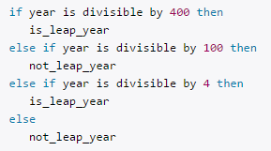
A leap year is a year containing one additional day (366 days a year). Review the leap year algorithm :

Slide 78
Find Leap Year or Not?
public class CheckLeapYear {
public static void main(String[] args) {
int year = 2000;
if ((year % 400 == 0) || (year % 4 == 0 && year % 100 != 0)) {
System.out.println(year +" is a leap year");
} else {
System.out.println(year +" is not a leap year");
}
}
}

Slide 79
output
2000 is a leap year

Slide 80
Gregorian Calendar Example
import java.util.GregorianCalendar;
public class CheckLeapYear {
public static void main(String[] args) {
int year = 1800;
GregorianCalendar calendar = (GregorianCalendar) GregorianCalendar.getInstance();
boolean result = calendar.isLeapYear(year);
if (result) {
System.out.println("leap year");
} else {
System.out.println("Not a leap year");
}
}
}

Slide 81

Exercise document

Slide 82
Quiz

Slide 83
Queries?

